Slide 1

PAH8001EI-2G
Cover Design Guide for Wrist
2015 Mar

Slide 2
Version History
Version No. | Note | Date
0.1 | First Version | 2013/12/10
0.2 | Adding Options | 2014/02/10
0.3 | Changing Slide Format; Adding Rubber Cover Materials & Process | 2014/03/18
0.4 | Revise Mechanical Structure | 2014/05/08
0.5 | Adding Step Design suggestions and update Double Injection drawings | 2014/05/20
0.6 | Modify Double Injection Surface Cover Drawing | 2014/05/29
0.7 | Revise Options | 2014/06/30
0.8 | Modify wording and add Standard Part | 2014/09/16
0.9 | Modify step design concept and surface cover cross-section | 2014/09/26
1.0 | Add Standard Part Surface Cover | 2014/12/02
1.1 | Modify Contents | 2015/03/03

Slide 3
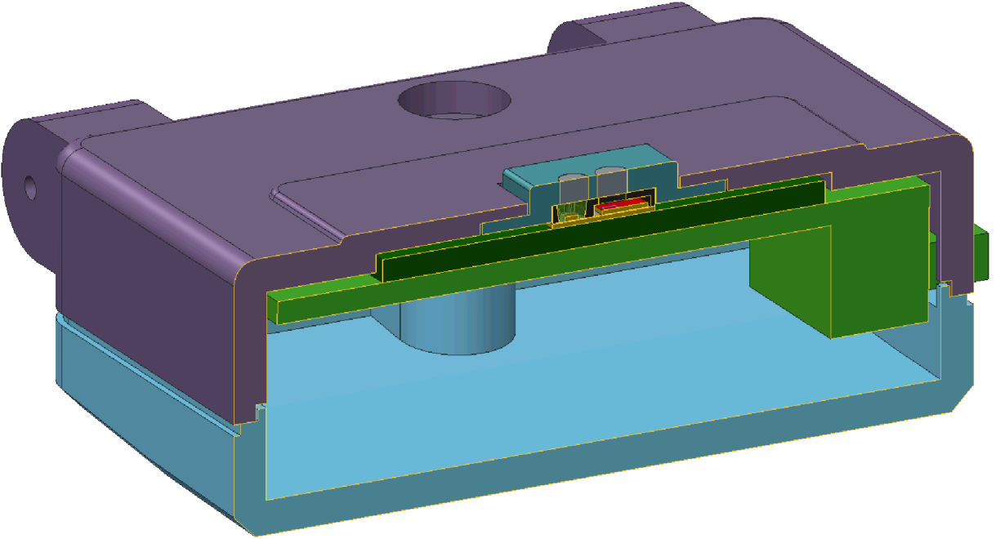
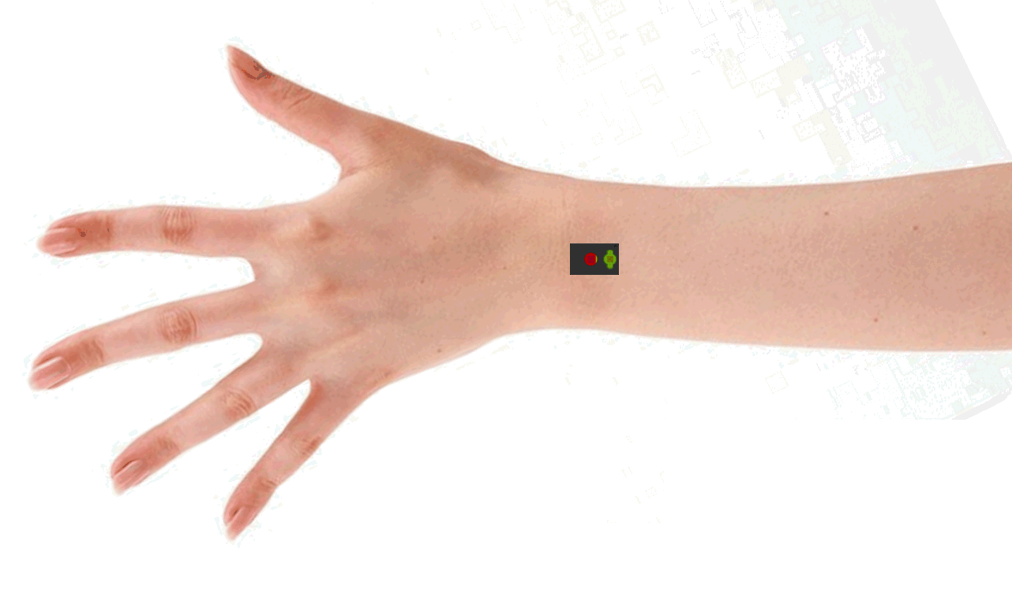
Introduction
This document is to let customer understand Mechanical Design for Consumer Products, such as Wearable Device.
Basic Requirement: Using Surface Cover with Double Injection
Also, PXI strongly suggests customer should use “step design” in order to improve contact between skin and sensor. PXI suggests that the protrusion part should be 0.5mm (or higher).
Based on the study, average SNR for step design is far better than flat design.
Note: tolerance +/-0.1mm
A. Protrusion thickness
Min: 0.5mm
Max: 2.5mm
B. Protrusion Area
Min: 4 x 6mm
Max:6 x 8mm
C. Parallel direction of LED/Sensor
line and wrist performance is
better than vertical direction
Protrusion from Surface
(
0
.
5
mm or Higher
)
Step Design Concept
Parallel direction of sensor and wrist

Slide 4
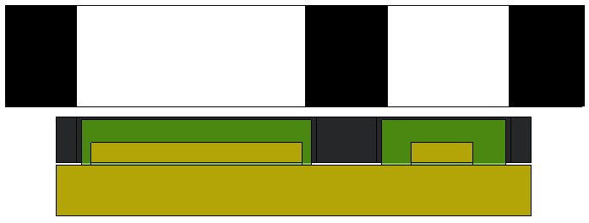
Surface Cover Cross-Section
Transparent Area
Black area
Transparent Area
Surface Cover
Assembly Tolerance
PAH8001 Sensor
LED
PAH8001 Substrate
Items | Description
Surface Cover | Materials: PC or PMMA (Double Injection) Thickness: 0.8mm (5 bar water resist) Black area width: 0.7mm±0.1mm, absorbency 99.99% @400~700 nm Ex. PC bayer 2805 Transparent Area Optical Requirement: PC/PMMA with 90% Transparency Ex. PMMA MF001 UV painting : 3HUV
Assembly Tolerance | Thickness: under 0.1mm (Best Case: 0mm)

Slide 5
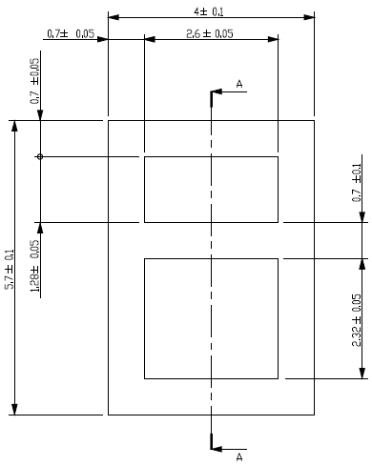
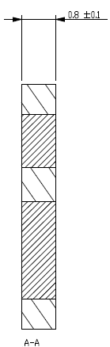
Surface Cover Reference – Customized Cover Pattern1 (Preferred)
PAH8001 Surface Cover Drawing Reference
Black area isolate LED and sensor
Customer could design the cover based on ID / waterproof requirement.

Slide 6
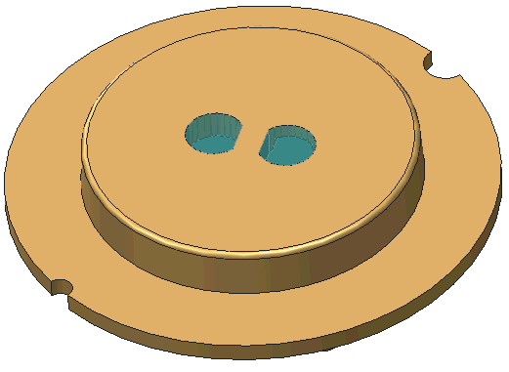
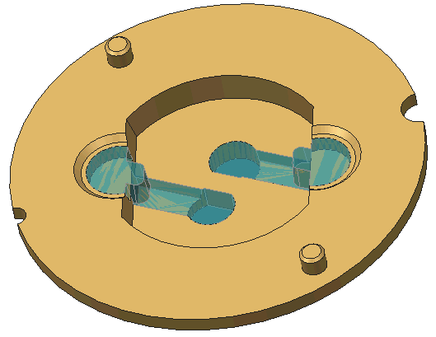

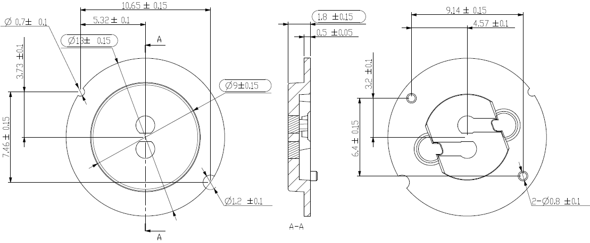
Surface Cover Reference – Customized Cover Pattern2
PXI can support sample
Water proof glue
Ex. 3M-VHB, 0.25mm thickness

Slide 7
Thank You !

